Slide 1
STGI Hackathon
Presented By:-
Aryaman Sharma- 22105005
Gaurav Dhiman- 22105006
Sanshray Mittu- 22105007
Harshul Singla- 22105025

Slide 2
User KVC Verification Problems- Design a comprehensive KYC (Know Your Customer) verification platform that ensures user authenticity through advanced image verification. The platform should capture a live image of the user, verify it against a provided ID document, and check a second image against a database for potential matches.
Solved this problem using
Tools- Facenet, MTCNN and OpenCV
Storage- Pinecone

Slide 3
Video Demonstration-
Spartans-Demonstration-Link

Slide 4
Why ANN over FAISS?
ANN- Approximate Nearest Neighbor FAISS- Facebook AI Similarity Search
1. Algorithm Flexibility-
ANN is a broad category encompassing various techniques such as KD-trees, locality-sensitive hashing (LSH), and graph-based methods. FAISS, while highly optimized, is primarily built around quantization- based methods and inverted files. ANN offers more diverse algorithms suited to different types of data.
2. Adaptability to Different Data Types-
Some ANN methods may perform better on low-dimensional data or data with certain properties (e.g., sparsity) compared to FAISS, which is optimized for high-dimensional data. ANN search techniques can be tailored based on data distributions, making them more adaptable to specific problem sets.

Slide 5
Continued…
3. Lightweight Implementations-
Some ANN algorithms can be more lightweight and require less memory than FAISS, which uses more complex indexing structures (e.g., product quantization). For smaller datasets or where memory efficiency is key, other ANN methods might be preferable.
4. Ease of Implementation-
Many ANN methods are simpler to implement and integrate, requiring fewer resources compared to setting up and tuning FAISS's more advanced indexing techniques. FAISS requires more setup, especially when using optimized hardware (e.g., GPUs), while simpler ANN algorithms may not need such optimizations.
5. Less Dependency on Specialized Hardware-
FAISS is highly optimized for GPUs and large-scale environments, which can be a disadvantage if you're working in a setting with limited computational resources. ANN search algorithms, like LSH, don’t always require specialized hardware and can still provide reasonable performance on lower-end systems.

Slide 6
About STREAMLIT-
Streamlit is an open-source Python library which enables the creation of web apps for data science and machine learning. No frontend knowledge required. Simple & Intuitive user interface design that Automatically generates UI elements for data visualization. Supports interactive widgets like sliders, buttons, and file upload. Instant feedback as data updates. Live data interaction with minimal code. Widgets can dynamically update plots and results.

Slide 7
Competitive Advantage of using Vector DB-
1. Efficient Similarity Search (Approximate Nearest Neighbor Search)
2. Scalability
3. Real-Time Processing
4. Integration with AI/ML Workflows
5. Integration with Big Data and Cloud Ecosystems
6. Growing Relevance in AI-Driven Industries

Slide 8
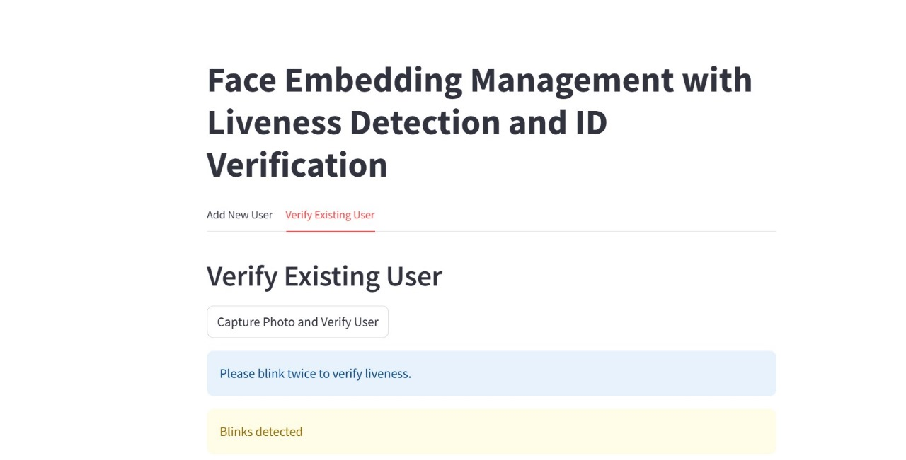
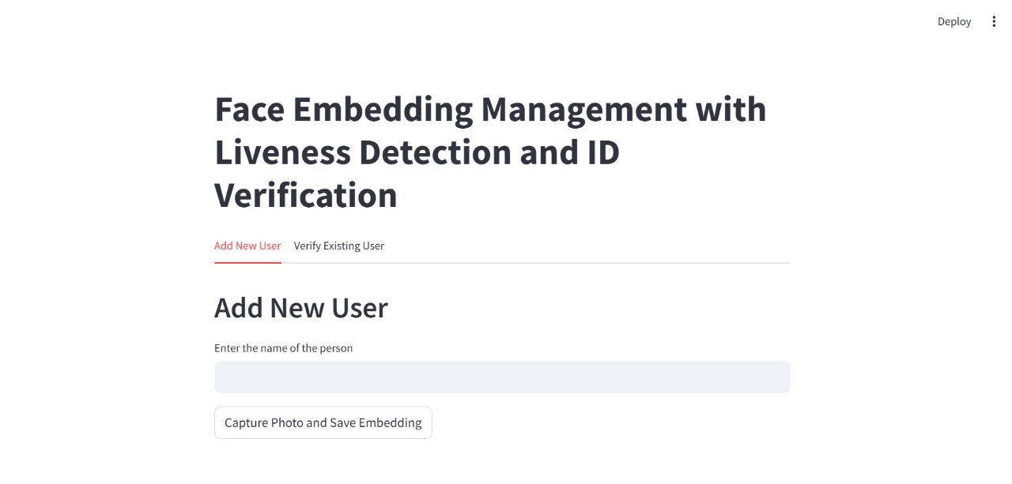
Snapshots from our video demonstration

Slide 9
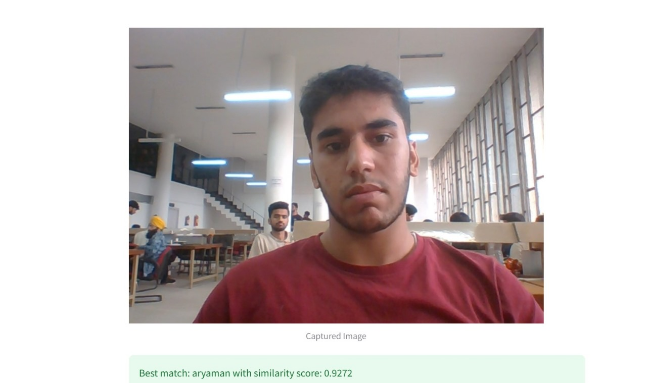
Successfully detected

Slide 10
Thank You!

